Slide 1


SAP S/4HANA CDS, RAP Training Day 1
Anubhav Oberoy

Slide 2


Introduction

Slide 3




Who is this course for?
Maria
Raphel
Rohan
Sofia
SAP ABAP Consultant
SAP Solution Architect
SAP Technical Consultant
Project Manager
Notes:
https://unsplash.com/photos/0Zx1bDv5BNY
https://unsplash.com/photos/315vPGsAFUk
https://unsplash.com/photos/DItYlc26zVI
https://unsplash.com/photos/FttBXHp7VZw
https://unsplash.com/photos/et_78QkMMQs

Slide 4

Agenda – Day 1
What is SAP HANA
Hardware and Software Innovations
Row v/s Column Store
SAP HANA System Architecture
SAP HANA programming paradigm
Setting up Eclipse and ABAP Dev Tool (ADT)
Setting up VS Code Development Tool
Introduction to SAP BTP
Setting up BAS Tool with BTP
Creating Dev Space in BAS tool
--Break
Introduction to CDS Views
Common Myths about CDS Views
Create your first CDS View
Consume CDS view in ABAP Program
Notes:
https://unsplash.com/photos/CPs2X8JYmS8

Slide 5
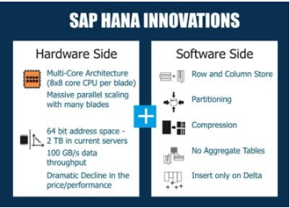
What is SAP HANA?
SAP HANA (high-performance analytic appliance) is an application that uses in-memory database technology that allows the processing of massive amounts of real-time data in a short time. The in-memory computing engine allows HANA to process data stored in RAM as opposed to reading it from a disk.
INNOVATIONS IN HANA
Several SAP HANA developers have made significant innovations in IT and in business models. Because of its in-memory approach, SAP HANA enables both hardware and software innovations which are unparalleled, replacing traditional databases in many spheres of business world! On the hardware side, SAP HANA facilitates Multi-Core Architecture (8×8 core CPU per blade), huge parallel scaling with several blades, 64 bit address space – 2 TB in current servers, data throughput as high as 100 GB/s, cost effectiveness and so on. On the software side, SAP HANA enables columnar data storage, partitioning, compression, eliminating aggregate tables, to name a few
01
Software Innovation
02
Hardware Innovation

Slide 6



















Aggregates

Slide 7


































Column Store

Slide 8
Hardware & Software Innovation
Hardware innovations
Drastic reduction in memory price
Ability to fabricate large memory in small chips
Multi-core CPU
Interruptible power supply
64-bit OS
Specialized hardware which even process data in upper cache of CPU
HANA installation only works on specialized hardware certified by SAP – HP, Lenovo, Dell
Software Innovations
Able to compress data and store
Row store v/s Column Store
Able to use the OS level virtualization
Process data parallel
Insert-only approach
No Aggregation

Slide 9
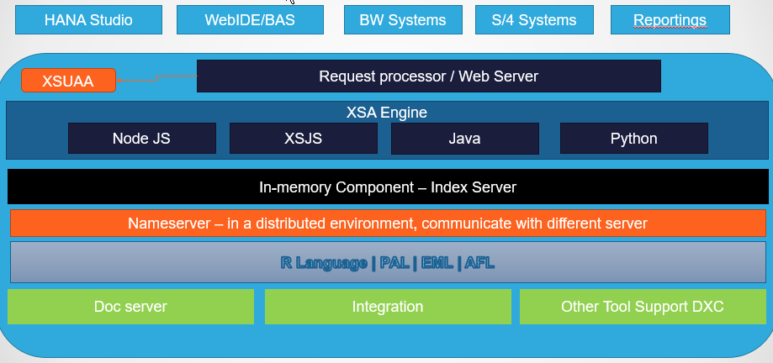
SAP HANA Architecture
SAP HANA System Architecture Overview. An SAP HANA system comprises multiple isolated databases and may consist of one host or a cluster of several hosts. An SAP HANA system is identified by a single system ID (SID) and contains one or more tenant databases and one system database.
Trainer: Anubhav Oberoy & Shubham Singh

Slide 10
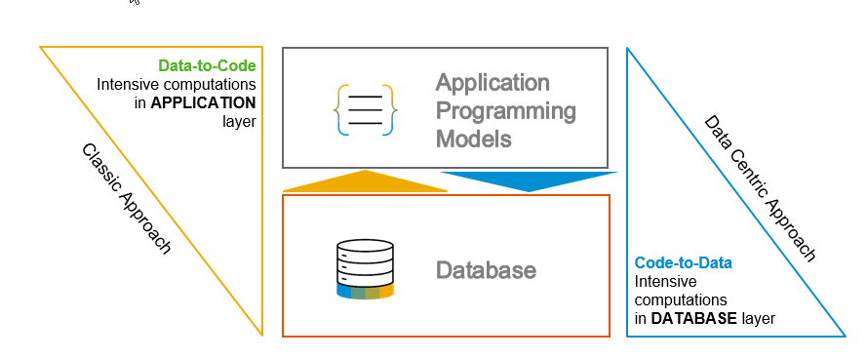
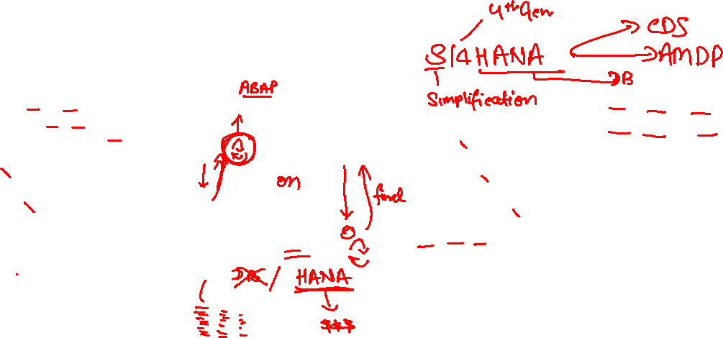
S/4 HANA, Suite on HANA and ABAP on HANA
Suite on HANA – Replace existing Any DB with HANA – SAP Product
S/4HANA – is also a product which is successor of Suite on HANA, Only runs on HANA – 2029 (all companies will be S/4)
ABAP on HANA – Technology on which these products are designed
Code push down
Code-to-data-paradigm
Most of the processing is pushed down to DB

Slide 11

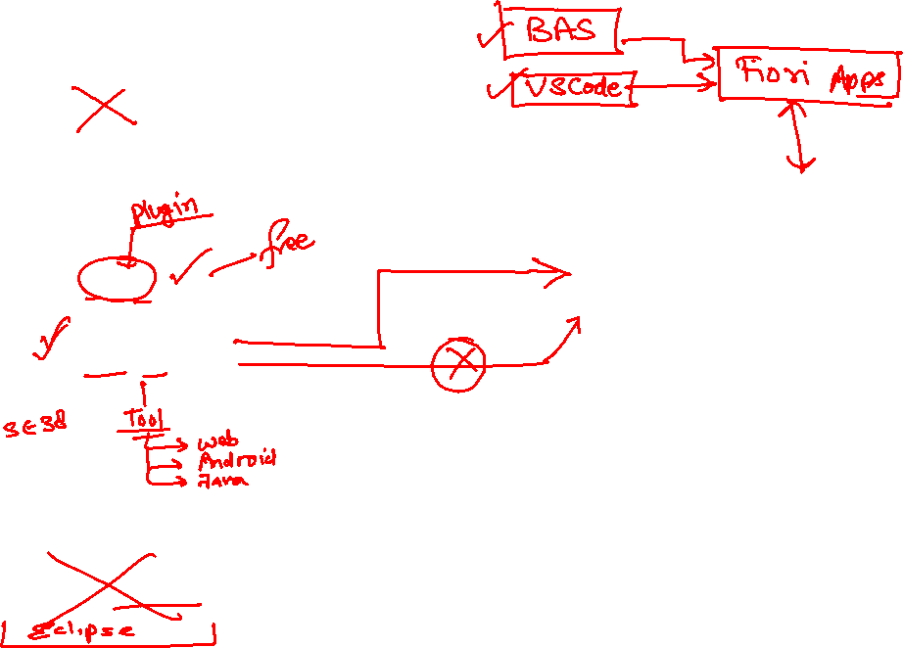
Development Tools
SAPGUI
ABAP Development Tools
Application
SAP Netweaver
ADT
program
Eclipse
(open source)
Database - HANA
HANA Studio
www.anubhavtrainings.com

Slide 12
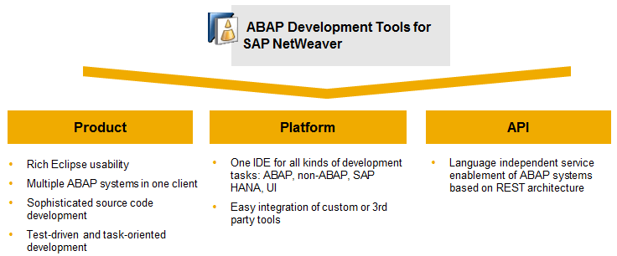
ADT Installation and System Access
ABAP Development Tools for SAP NetWeaver (ADT) enables ABAP developers to perform development tasks using the ABAP application server capabilities in an Eclipse-based IDE or on the classic ABAP Workbench.

Slide 13
Setup of Eclipse and ADT
Official documentation - https://tools.hana.ondemand.com/#abap
Pre-Requisites:
You must have to have Java 1.8 and above
You must have SAP GUI already installed in your system
Also for windows laptop needs the For Windows: Microsoft Visual C++ 2013 Redistributable (x64) (Note: Precisely version Visual Studio 2013 (VC++ 12.0) x64 is required).
Procedure
To install the front-end component of ADT, proceed as follows:
Get an installation of Eclipse 2023-06 (x86_64) (e.g. Eclipse IDE for Java Developers)
In Eclipse, choose in the menu bar Help > Install New Software...
Enter the URL https://tools.hana.ondemand.com/latest
Press Enter to display the available features.
Select ABAP Development Tools and choose Next.
On the next wizard page, you get an overview of the features to be installed. Choose Next.
Confirm the license agreements and choose Finish to start the installation.
www.anubhavtrainings.com

Slide 14
Benefits of ADT
Eclipse is a free tool and open source used by billions of developers in industry
You can work simultaneously with Dev, Qlt, and production
It is also seamlessly integrated with SAP GUI, you can use Ctrl+6 to open a GUI window.
Different systems, different landscapes, different types comes together in a single development environment, it will help to avoid context switching as a result we have better developer experience
Flexible and customizable development environment (Ctrl+M)
Fast search and navigation capabilities using Ctrl+Shift+A
For ABAP on HANA development this is the Only tool you must have to use –CDS Views, AMDP etc.
Support for Transport, Debugging, Profiling and ATC check features
Eclipse is multi purpose tool – ABAP, Java, Java Script, Web, C, EJB, UI5
It supports all SAP developments – Scripts, Dialog, Webdynpro, DDIC, Classes, RICEF
Inbuilt Quick fix feature
Modularize your code easily
Code templates
www.anubhavtrainings.com

Slide 15

Setting up VS Code Development tool
Development tool – VS Code (free, offline, billions of dev) + Extensions (Java Extension pack, Spring Extension pack, Fiori Extension pack and SAP CDS language support)
https://code.visualstudio.com/download

Slide 16




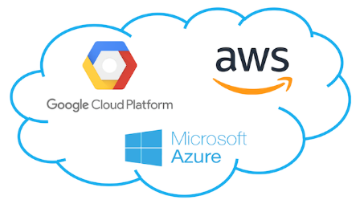
WHAT IS SAP BTP?
Application
Application
Data
Data
Runtime
Platform as a Service
Managed by SAP implementing open source CF
Middleware
Fully ready landscape with reusable services
Scalability
Elasticity
Low TCO
Database
OS
Virtualization
Infrastructure as a Service
Managed by Infrastructure
providers
Servers
Storage
Networking
www.anubhavtrainings.com

Slide 17
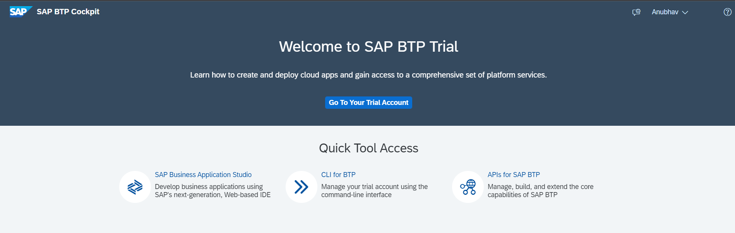
Setup free BTP account
https://account.hanatrial.ondemand.com/trial/#/home/trial

Slide 18
Created for region and department
FIN - US
5GB, 1BAS
Global A/c
Represents an SAP Customer for billing purpose
Entitlements
2BAS,3HDB,10GB
HR - IN
3GB, 1 BAS
D Space – 0.5
Q Space – 0.5
MKT - SG
2GB
P Space - 2

Slide 19
Introduction to BAS tool
SAP Business Application Studio is a development environment available on SAP Business Technology Platform. Before you can start developing using SAP Business Application Studio.
In an Enterprise Account you can set up SAP Business Application Studio as a Free-Tier service by checking its free plan during its entitlement configuration.
The business application studio provides a dev space for developers to create private workspace to have pre-defined dependencies installed for creating particular type of applications e.g. sap fiori, Native HANA development, Cloud application programming development etc.
Dev Space
Dev Space
BAS
BTP - CF
BTP - CF
AWS – IaaS – US – 100GB

Slide 20
What is CDS and Some common Myths
CDS stands for Core Data and Services, They are used ABAP on HANA systems (mainly S/4HANA) to define data definitions and semantically rich data (annotations) models. They supplements the SQL code in ABAP. It is an extension of SQL in ABAP layer.
What has been extended?
DDL (Data Definition Language) – people don’t use this much because we have SE11 and its one time job
DQL (Data Query Language) – View concept – 95%
DEL (Data Expression Language)
DCL (Data Control Language)
Can I create CDS views in my company system even we are not on HANA?
Yes, Your SAP NetWeaver must be above NW 7.4 SP6
Is CDS concept only used to create views, or there can be another use case of CDS?
We can define types using CDS.
Which layer do we create CDS view.
Create them in ABAP layer, on activation a HANA view (runtime object) gets created in HDB
Which tool do we use to create CDS views, is SAPGUI used?
ADT, GUI CANNOT be used.
www.anubhavtrainings.com

Slide 21
Some common Myths….
Which is the minimum SAP NW version required to create CDS views, is it mandatory to use HDB?
SAP NW 7.4SP6, HANA is not mandatory but for BEST performance you should use HANA
I heard about HANA CDS, how HANA CDS different from ABAP CDS?
In this course, we only learn ABAP CDS. HANA CDS is used in Native HANA Dev.
https://www.youtube.com/watch?v=rTsAg_OGh-A
If you got to choose between CDS and AMDP?
CDS is first preference. CDS works on database agnostic, client handling, complexity.
We already have 4 types of views in ABAP, Why should I learn CDS view now?
Park
What is the actual Code to data paradigm object which is created in HANADB?
A HANA view gets created in HDB which is the actual runtime object called when you run CDS.
www.anubhavtrainings.com

Slide 22
Some common Myths…
I am from BW background, have no idea on ABAP, can I learn CDS views?
Yes, You must learn because now a days companies moving from Bex to CDS views. No ABAP required.
Will CDS views only be created in S/4HANA systems?
No, Any ABAP on HANA systems above NW7.4 SP6
How CDS views different from Calculation view you taught earlier?
Calculation views are bottom-up approach cannot use this approach in S/4HANA. CDS views are top-down
What are the types of CDS views?
Parameterized CDS views and Non-parameterized CDS views
Is it also possible to insert/update data using CDS views?
No. If you combine CDS view concept with frameworks like BOPF or RAP
What is the best practice/gold standard to create CDS views?
VDM – Virtual data modelling – guidelines to build cds views in S/4HANA
www.anubhavtrainings.com

Slide 23
Some common Myths..
Are there standard CDS views delivered by SAP, can I see them?
Yes. https://api.sap.com
Is it possible to extend standard SAP delivered CDS views?
Yes
Anubhav, recently my friend told me that CDS views are deprecated, is it true?
Yes, there is a new concept called CDS entity, which identically.
I worked in a project where we use something called VDM?
It is a best practice to create CDS views.
www.anubhavtrainings.com

Slide 24
Some common Myths…
Can I integrate SQL Script also using CDS?
Yes, there is a advance concept called CDS table function starting NW 7.5
Can I also secure my data coming out of CDS view with some kind of Authorization/Role?
Yes
I tried hard to learn CDS from google, but rather learning I got more confused?
Park
What is metadata extension in CDS?
Park
www.anubhavtrainings.com

Slide 25
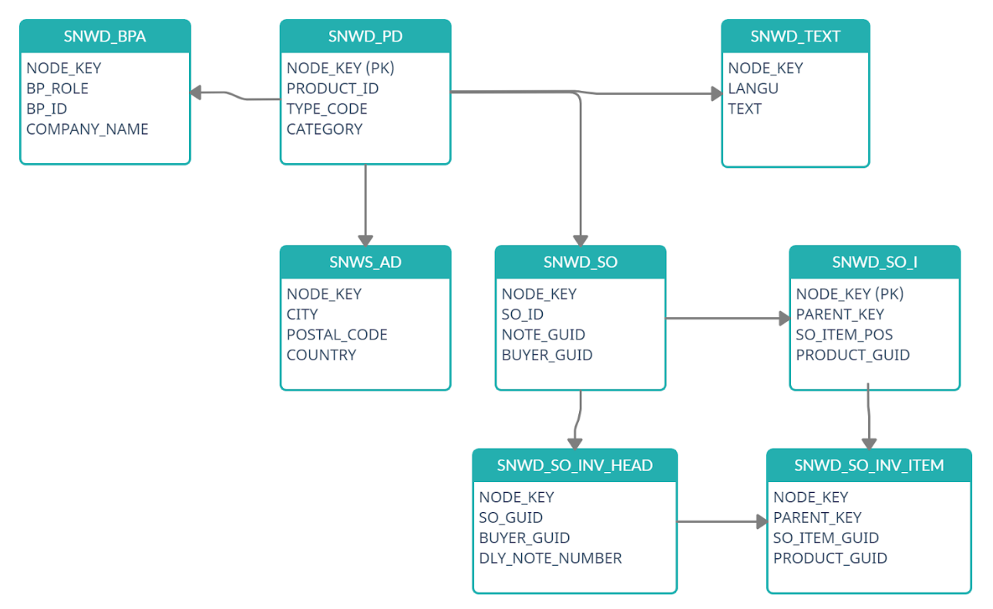
EPM Data Model

Slide 26
What happens when we activate
DDIC view SE11
CDS views
activate
HANA Views
www.anubhavtrainings.com

Slide 27
Create First CDS view
@AbapCatalog.sqlViewName: ‘ZMTXXBASICCDS'
@AbapCatalog.compiler.compareFilter: true
@AbapCatalog.preserveKey: true
@AccessControl.authorizationCheck: #NOT_REQUIRED
@EndUserText.label: 'Simple CDS view'
define view ZMT_XX_BASIC_CDS as select from snwd_bpa
{
key node_key as NodeKey,
bp_role as BpRole,
email_address as EmailAddress,
address_guid as AddressGuid,
bp_id as BpId,
company_name as CompanyName
}

Slide 28
Consume CDS in ABAP program
*&---------------------------------------------------------------------*
*& Report zmt_xx_call_cds
*&---------------------------------------------------------------------*
*&
*&---------------------------------------------------------------------*
REPORT zmt_xx_call_cds.
data ls_bp type snwd_bpa.
SELECT-OPTIONS s_bpid for ls_bp-bp_id.
select * from ZMT_XX_BASIC_CDS into table @data(itab) where BpId in @s_bpid.
cl_demo_output=>display_data(
value = itab
* name =
* exclude =
* include =
).

Slide 29

Questions?

Slide 30

Thank you
Anubhav.abap@gmail.com
contact@anubhavtrainings.com
+91 84484 54549
www.anubhavtrainings.com

